Slide 1
Lineament Density

Slide 2
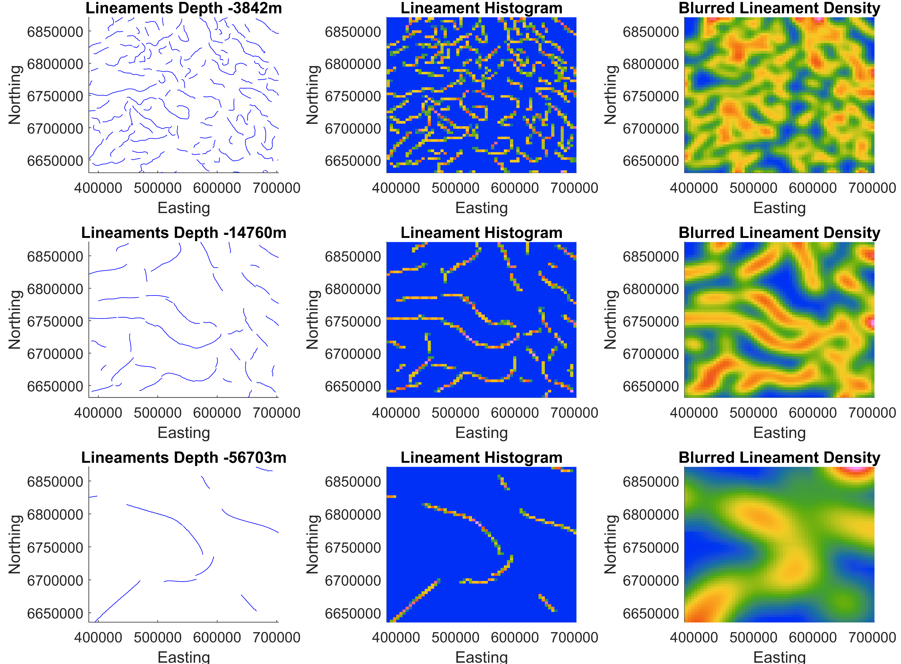
Multiphysics Lineament Density
Regions of deep structures determined by regions of overlapping lineaments at separate depths
The points of the lineaments at each depth are first spatially pooled
A 2D Gaussian filter is then applied to spatial pool the histogram. The standard deviation of the filter is linearly scaled for the depth slices
This allows the deeper lineaments to have a greater spatial influence when the blurred densities are summed together
Bouger Gravity Anomaly worms spatially pooled and Gaussian blurred. The size of the Gaussian filter is scaled proportional to the depth

